Slide 1
2024 closure of scallop grounds in Area 7d
FMAC Scallop sub-group
3 July 2024
Andrew Brown
Macduff Shellfish

Slide 2
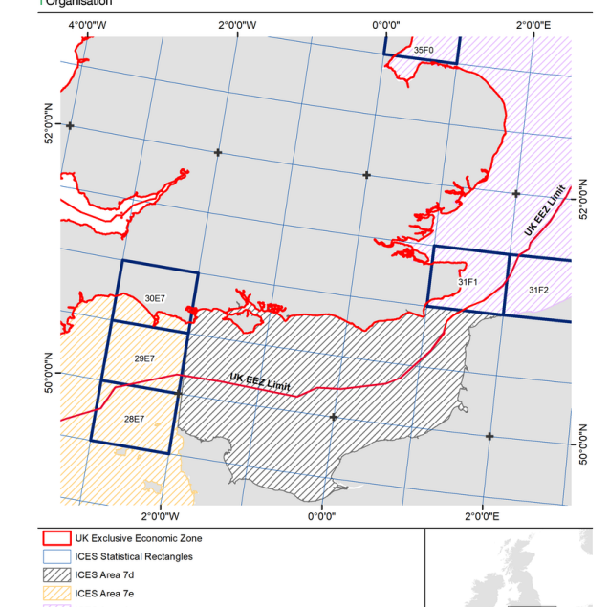
EU and UK closures in area 7d

Slide 3
Timeline
7 Dec. 2023 – 14 Jan. 2024
Consultation
2 Apr. 2024
Initial Announcement
16 Apr. 2024
Stock advice published
9 May 2024
Final decision
15 May 2024
Closure comes into force

Slide 4
MMO Justifications (and counter-arguments)
Provide increased protection during primary spawning period (May – October) – (no evidence that such closures provide increased protection; ignores importance of “roe-on” market)
Spawning Stock being exploited close to MSY, above in 2022 (MSY is an optimum – not a ceiling)
Fully avoid displacement of effort from king scallop closure in EU (UK adopts a management system designed to meet needs of EU fleet and their markets)
Reduce displacement which caused 39% increase in King scallop landings in 7d (Entirely to be expected – a consequence of standalone closures.)

Slide 5
Industry anger
Extended closure follows improvement in stock condition and downward revision of fishing pressure. No reward for industry accepting conservation measures.
Economic implications not considered – are proving considerable.
Short notice – less than 1 week prior to closure.
Closure imposed following prolonged and constructive effort by industry and DEFRA to develop co-management.
Scotland – Scottish Government “signed off” the agreement in spite of disproportionate impact on Scottish vessels.

Slide 6
7d closures in 2025?
MMO accept no automatic roll-over of 2024 closure into 2025.
MMO acknowledge communication and consultation lessons to be learned.
Science surveys need to be considered earlier in process.
Impact of displacement on other grounds needs to be assessed.
Anecdotal claims of increased gear conflict due to displacement needs to be taken into consideration in future decisions.
UK measures should not simply “mirror” EU measures but be designed to suit UK stocks, fishing patterns, fleets and markets.

